Slide 1
PmB use in Europe
Thibaud GALLET, TOTAL.

Slide 2
Content
The European Market
Common technologies
Characterisation
  Regular standards (En 14023)
  Performance Related Specifications
  Mixes tests
Field performances
  Wearing courses : Durability
  Base courses : Thickness reduction
  Recycling

Slide 3
The European Market
3
- Intersectorial Forum: Bitumen and PmB, 30/03/2011, St Petersbourg

Slide 4
Evolution of PmB sales
Growing volumes for 10 years …
… but constant percentage : 16%
  2.5MT over 16MT total bitumen production (source Eurobitume)
PmB kT sold by year in Europe
Source : EAPA

Slide 5
Evolution of PmB sales
Variability over different countries
% of PmB in total bitumen for road (Source Eurobitume, 2011)

Slide 6
Common technologies
6
- Intersectorial Forum: Bitumen and PmB, 30/03/2011, St Petersbourg

Slide 7
What is the Ideal binder?
Good Workability
  Low viscosity at high temperature
Good Stability
  Storage : no phase separation - good compatibility
  Hot mix plant & long term aging - low oxidability
Low Temperature susceptibility
  High stiffness at high pavement T. - Anti rutting
  Low stiffness at low pavement T. - Anti cracking
High resistance to loading
  High capacity of elongation - Anti cracking
  Fatigue resistance at intermediate T. - Anti cracking

Slide 8
Polymer types
Plastomers = Plastics (PE, PP, EVA, EMA, EBA, ...)
  Tough, Strong, Rigid
  Physical Properties:
    High Creep Resistance - Rutting Resistance
    High early Tensile Strength
    Low strain at fracture
  ! Compatibility can be questionable depending on polymer nature
Elastomers = Rubbers (SBS, SBR, SIS, PC, EPDM, ...)
  Flexible, Resilient, Pliable
  Physical Properties
    High Creep Resistance - Rutting Resistance
    High Strain at Fracture
    High Resistance to Fatigue related Fracture
Crumb Rubber (Mainly In Spain and Portugal)
  Storage stability issues
  Durability issues

Slide 9
Additives
Acids, Wax, Xlinkers, …
  In Europe, most bitumen is straight run (little blown bitumen)
  ➔ Need verify additives action on every particular bitumen
No oil extenders
  Not a used technology in Europe
  HSE issues (fumes and light fraction)
  Technical problems ?

Slide 10
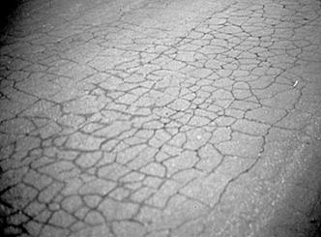
Field validation study: Valais test sections
Pure binders and PmBs
Cracking index (High index = many cracks !)
10 years
10yrs
16 binders
7 years
4 years
3
6
7
15
1
5
14
16
13
4
2
10
12
8
9
WARNING : All PmBs are not the same on the long term !!!
➔ High importance of the formulation !!
- Intersectorial Forum: Bitumen and PmB, 30/03/2011, St Petersbourg

Slide 11
Characterisation
11
- Intersectorial Forum: Bitumen and PmB, 30/03/2011, St Petersbourg

Slide 12
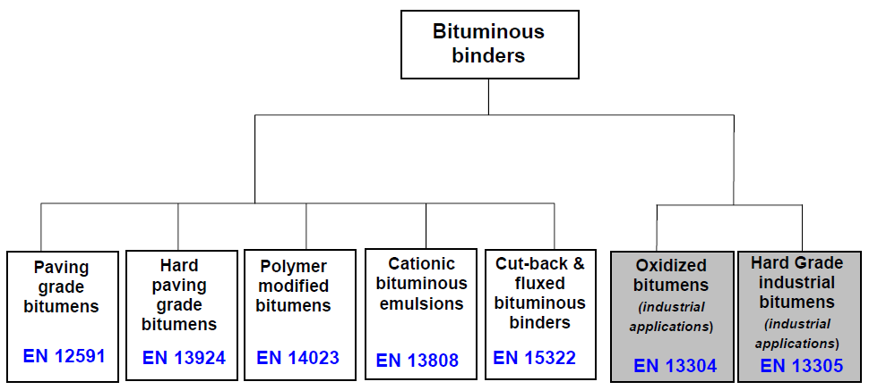
Regular standards – EN 14023

Slide 13
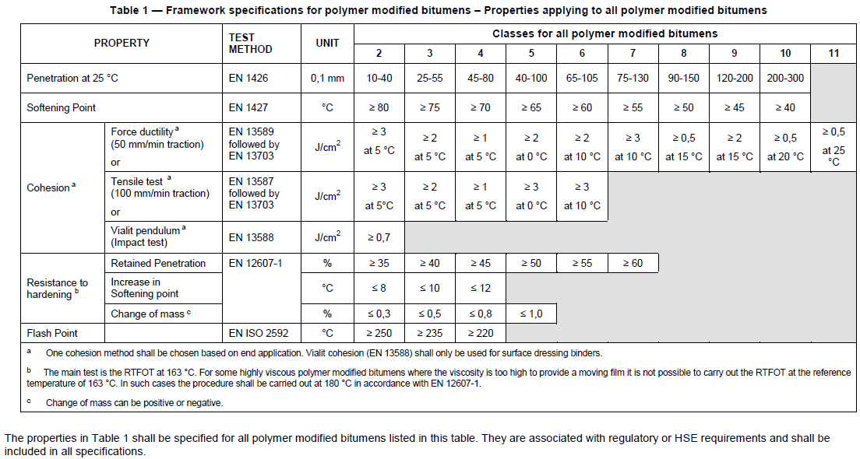
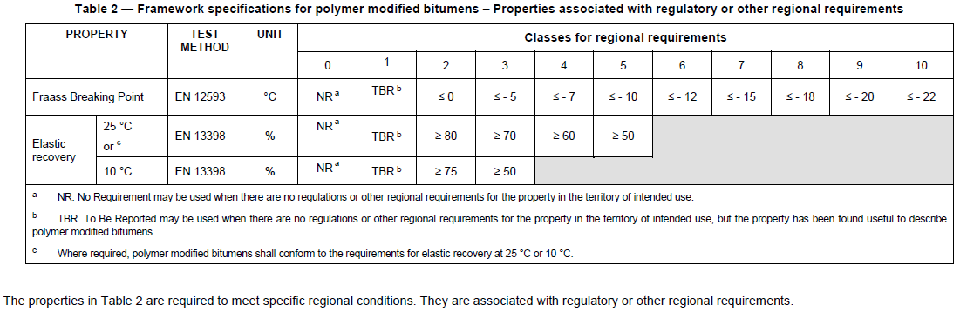
Regular standards – EN 14023
MANDATORY
Pen
R&B
Force Ductility
Traction
Vialit Pendulum
RTFOT
Flash Point
REGIONAL
Fraass
Elastic Recovery

Slide 14
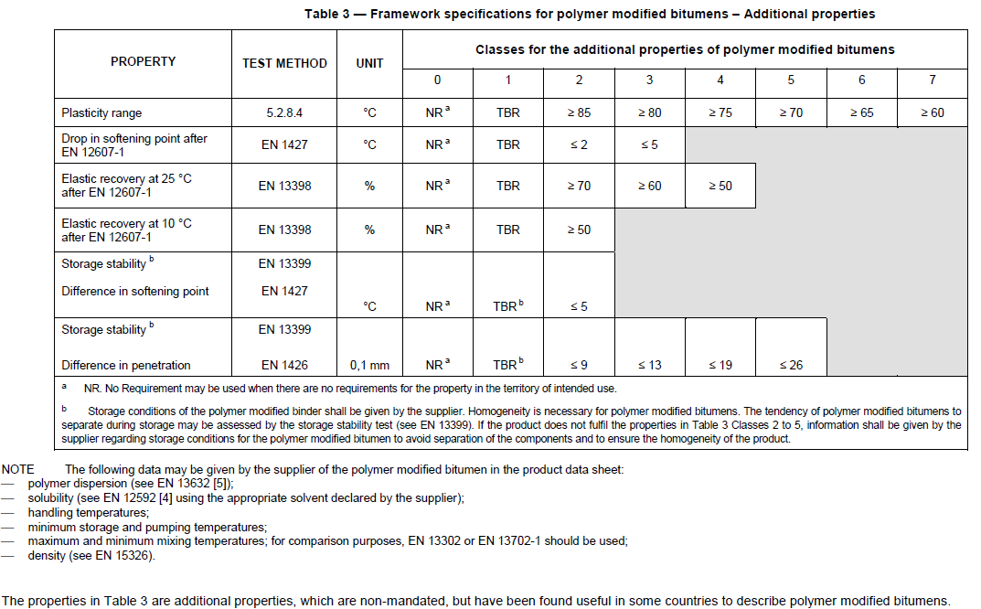
Regular standards – EN 14023
ADDITIONNAL
Plasticity range
ΔR&B after RTFOT
Elastic Recovery after RTFOT
Storage stability

Slide 15
Performance Related Specification
(CEN TC336 – WG1 – TG5)
CPD | Performance requirement of Binder (Characteristic) | Property | Test method | Levels/classes
Unaged
Binder grading properties
 | Mixing & Handling | Dynamic Viscosity @ XX °C | EN 13702 | Table 2.1
ER 3 | Safety | Flash Point | EN ISO 2592
 | Storage Stability
STA
ER 1 (hi T) | High Service Temperature Permanent deformation | Non-recoverable creep compliance, 1/kPa | Not an EN standard method
ER 1(int T) | Bearing capacity | Complex Modulus, kPa/° C | EN14770 | Table 2.2
ER 1 (int T) | Fatigue cracking (incl healing) |  | No harmonised method yet
LTA
ER 1(int T) | Fatigue cracking (incl healing) |  | No harmonised method yet
ER 1 (lo T) | Resistance to fretting
ER 1 (lo T) | Low temperature cracking | BBR, Temperature at 300MPa Change in properties vs Unaged | EN14771

Slide 16
Performance Related Specification
(CEN TC336 – WG1 – TG5)
High service temperature resistance to permanent deformation/rutting | DSR: G*/sin(delta) | EN 14770
 | DSR: MSCR | ASTM D 7405
 | DSR: LSV | CEN TS 15324
 | DSR: ZSV | CEN TS 15325
Resistance to thermal cracking under Low service temperature | BBR after RTFOT & PAV | EN 14771
 | DSR after RTFOT & PAV at low temperature Stiffness measurements | EN 14770
 | Fracture Toughness after RTFOT & PAV | CEN TS 15963
 | Direct Tensile Test | EN 13587
High temperature
  Correlation R&B vs rutting
  High R&B does not systematically means high rutting resistance (high oil extender content for instance)
Low temperature
  Fraass : bad repeatability and significance
Fatigue performance
  Elastic Recovery ???
  Tests are too long
Resistance to fretting
  Cohesion tests ???

Slide 17
Mixes – EN 13108 (Formulas) and EN 12697 (Performances)
Final criterion is mix performances (France)
2 types of norms
  EN 13108 → formulas
  EN 12697 → Mix performances
    Workability (EN 12697-10 : Gyratory Compaction, Marshall)
    Water resistance (EN 12697-12, 23 : Duriez, ITSR)
    Rutting (EN 12697-22 : French Wheel Tracking Device, Hamburg Test)
    Modulus (EN 12697-26)
    Fatigue resistance (EN 12697-24 : 2 PB-T, 4PB, …)
    Cracking (EN 12697-44 : SCB, …)
    …
Other tests that may be conducted
  Ravelling
    Tests for surface dressing
    TOTAL Caroussel
  Fuel and Deicing resistance
  …

Slide 18
Field Performances
18
- Intersectorial Forum: Bitumen and PmB, 30/03/2011, St Petersbourg

Slide 19
Wearing course
Durability

Slide 20
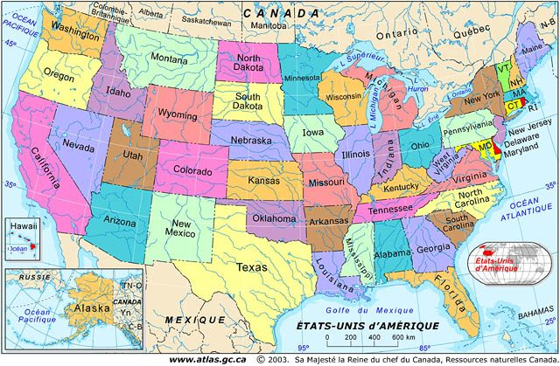
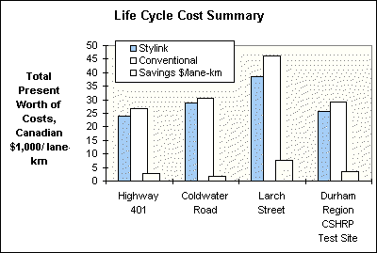
Wearing courses
Life Cycle Cost Analysis is favorable
  Higher price ...
  ... but longer life
    ~14 years in France
    Examples of 20-year service life (Switzerland)
  No studded tyres in Europe (banned) except for Scandinavia
Usage
  SMA
  Thin layers
  Draining courses
  Highly stressed zones
    Highways
    Intersections
    Roundabout
    Airport
10%
7%
15%
10%
Source: JEGEL (road contractor, Canada)

Slide 21
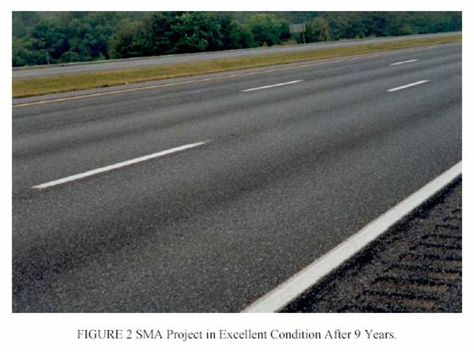
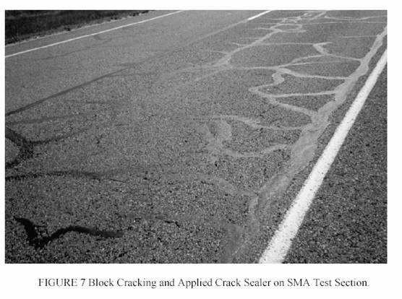
PmB vs. unmodified bitumen: US reference
Comparison after 9 years
PG 76-28
Pure bitumen
Source: TRB 2003
Updated review of SMA and Superpave projects – paper 03-4135 from Department of Transportation (DOT)

Slide 22
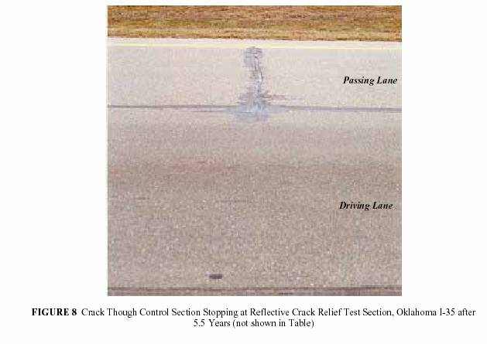
PmB vs. unmodified bitumen
Comparison after 5.5 years
Pure bitumen
^{PMB}
Source: TRB 2003
Interlayer and Design Considerations to Retard Reflective Cracking - paper 03-3509 – Koch Stylink Technique (based on Styrelf® Technology) after 5.5 years

Slide 23

PmB durability
German experience on bridge decks
Motorway bridge near Hamburg on A1, opened since 1984!
for this type of bridge deck, Gussasphalt (mastic asphalt) is traditionally used in Germany
Lifetime with standard bitumen is usually 6 to 7 years
PmB application is still in use & yet in good shape after more than 24 years in service !
- Intersectorial Forum: Bitumen and PmB, 30/03/2011, St Petersbourg

Slide 24
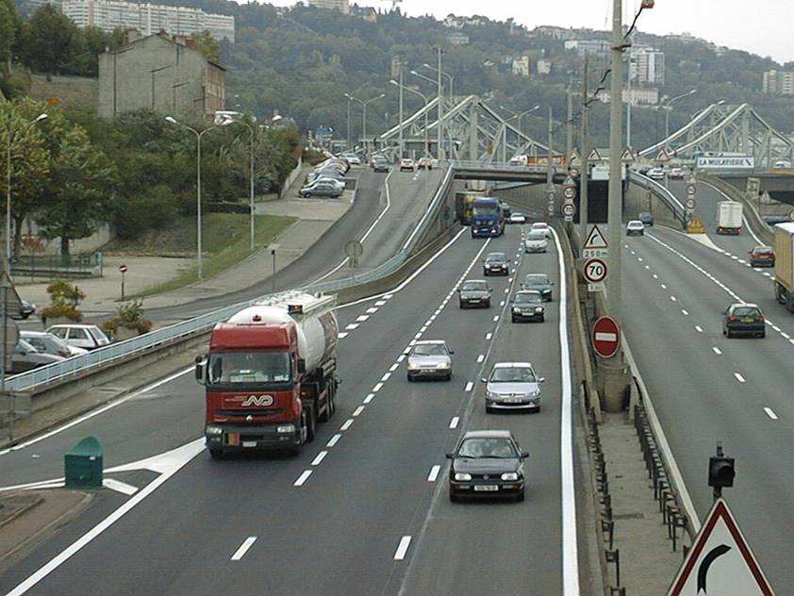
PmB high modulus mix –
A7 Lyon La Mulatière (France)

Slide 25
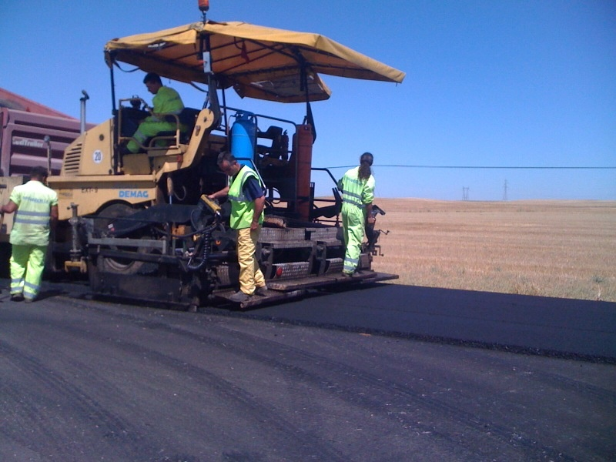
PmB in Spain – road in Bejar (Castilla y León) 1996

Slide 26
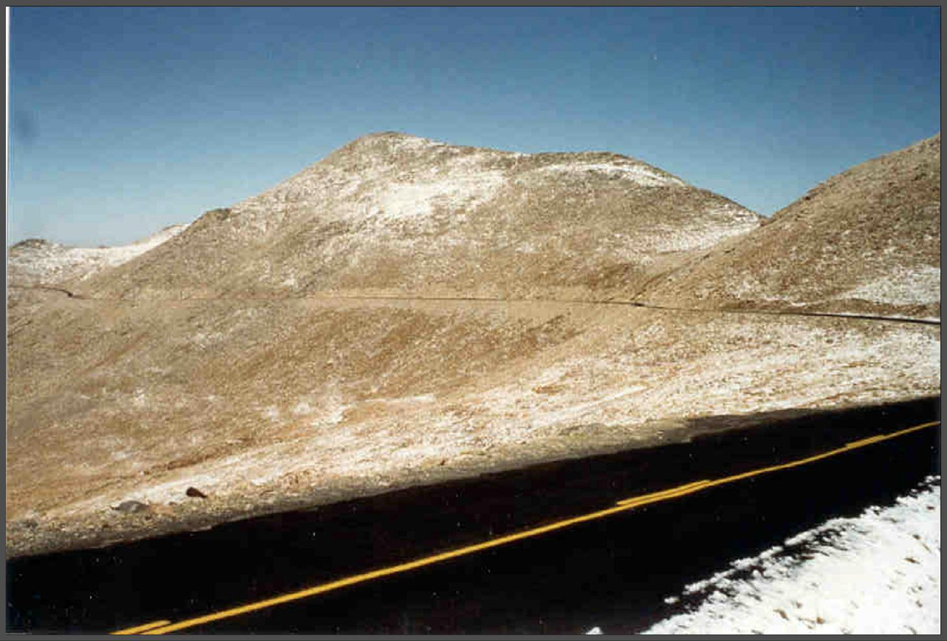
Chip seal with PmB in the « Rockies »
(Mt Evans 4359 m, Colorado - USA)
- Intersectorial Forum: Bitumen and PmB, 30/03/2011, St Petersbourg

Slide 27
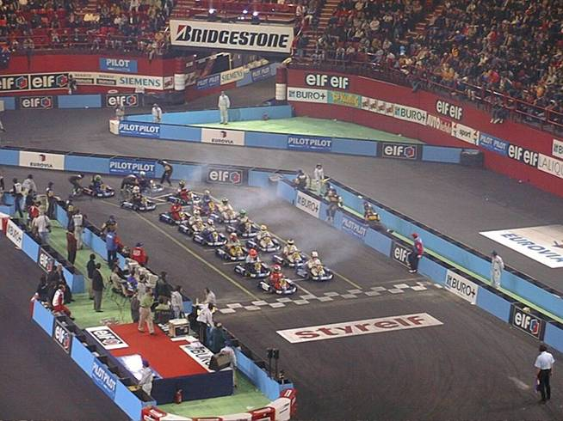
PmB high performance –
Karting track at POPB (Paris Bercy - France)
☞ resistance in tangential efforts

Slide 28
Base layer
Thickness Reduction
- Intersectorial Forum: Bitumen and PmB, 30/03/2011, St Petersbourg

Slide 29
Base layers - thickness reduction
Extra performances brought by PmBs
  High fatigue resistance
  No or low degradation of the modulus
Road design
  Use of pavement design models (Alize
  in France, MEPDG in US)
  Same lifetime requires less materials
  → Reduction by 10 to 50% of layer thickness
Advantages
  Costs reduction
  Road works in constrained area (bridges, city, …)

Slide 30
Recycling
- Intersectorial Forum: Bitumen and PmB, 30/03/2011, St Petersbourg

Slide 31
Recycling
Objective : re-use milled road in the same layer
Need for a performance booster to compensate defects from the old bitumen
→ PmB
A growing habit in Europe
  Milled asphalt reused in road
    >70% of RA used: Austria, Germany, Netherlands and Sweden
    50-70% of RA: Belgium, Denmark, Hungary, Spain, Switzerland
    20-50%: France, Czech Republic and Italy
    <20%: Norway and Poland
  Economics (scarcity of good aggregates, bitumen price)
  Politics incentives
Germany, Netherlands → Highly modified PmBs

Slide 32



спасибо
- Intersectorial Forum: Bitumen and PmB, 30/03/2011, St Petersbourg

Slide 33
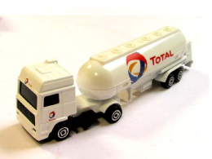
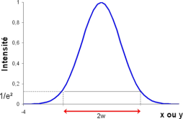
French dimensionning method
Road structure
(layers + E, ν)
Structure = elastic beam
Reference axle load
Stress and Strain fields in the structure
^ ?
Temperature
Bearable Stress and Strain by each layer
Trafic intensity
Fatigue test (ε6)
Modulus test (E*)
Material properties
LCPC empirical model
Usual material properties from LCPC database (CAM, ν, ..)
Risk factors
Lifetime
Back

Slide 34
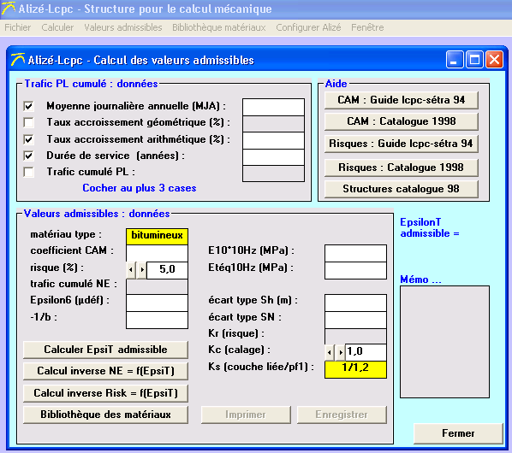
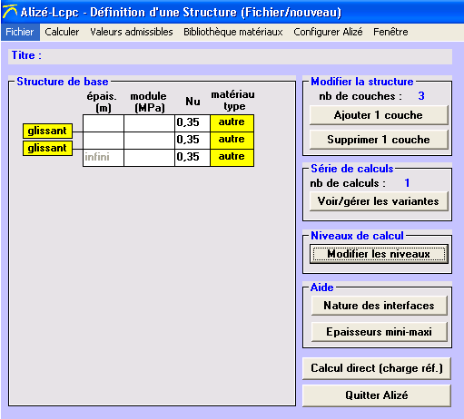
French dimensionning method
LCPC « Alizé » software
  LCPC: Laboratoire Central des Ponts et Chaussées
  → French central laboratory for bridges and roads
  Based on French road dimensionning method
  Input
  Characteritics of asphalt mix (modulus, fatigue)
  Traffic (trucks / day, evolution of traffic,
  characteristics of trucks axles)
  Temperature
  Life duration
  Risk coefficient
  Properties of subgrade
  Output
  Layer thickness
  (iterative method)

